Slide 1
Roadmapp MVP
Team: Sharony Braam & Daan Brocatus

Slide 2



Feedback
Visual update Achievements
Use icons
Order by value

Slide 3
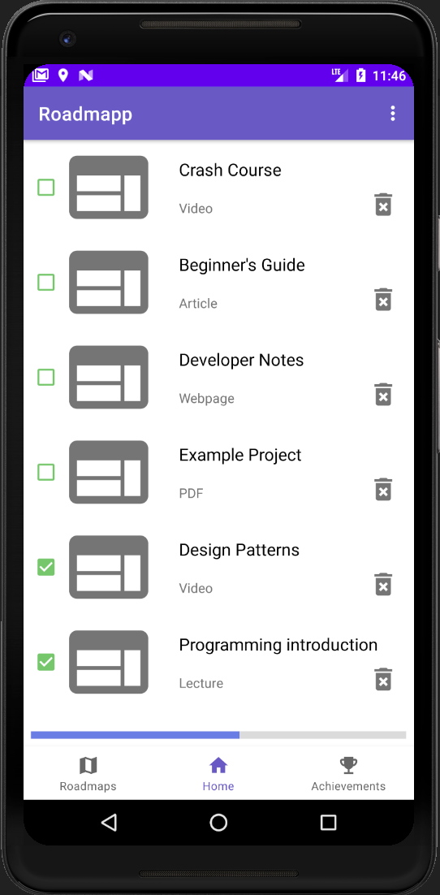
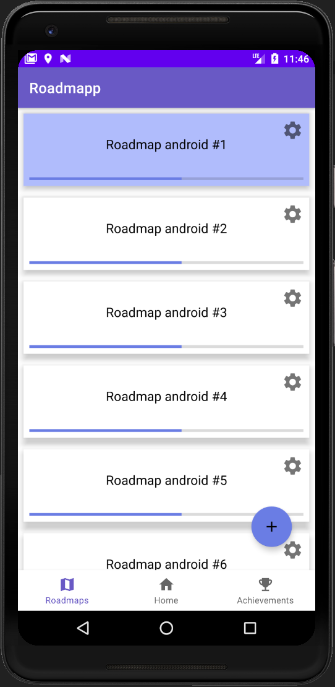
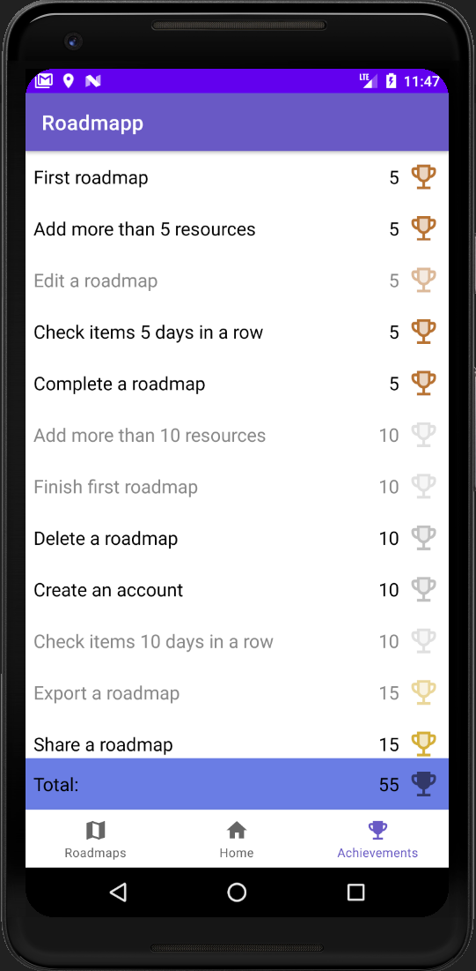
Minimum Viable Product

Slide 4
Demo

